Slide 1


Slide 2
Plagued by pollution Thneedville is the embodiment of Seuss’ vision of future societies.

Slide 3
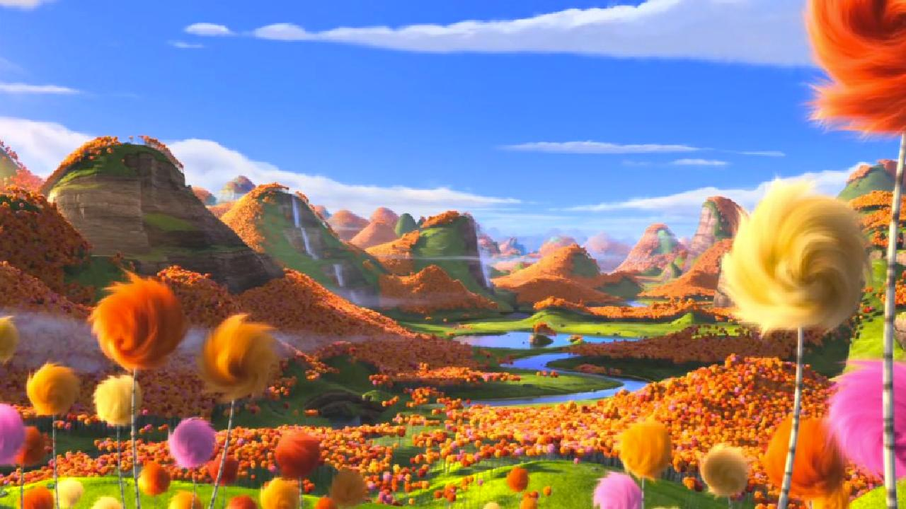
“Pre-Thneedville: A land rich with natural resources.

Slide 4
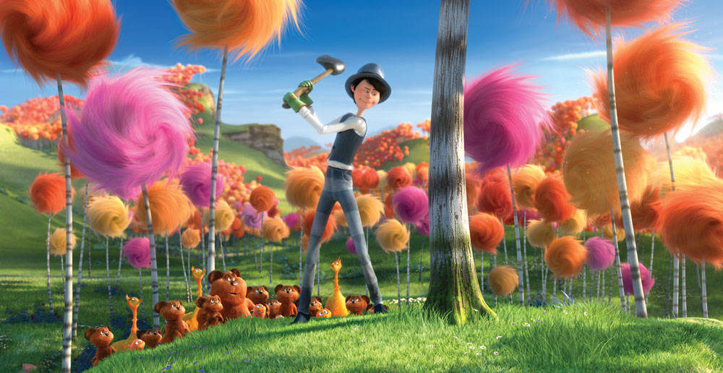
The Once-Ler justifies his actions each time saying “It’s only one tree, how bad can it be?”

Slide 5
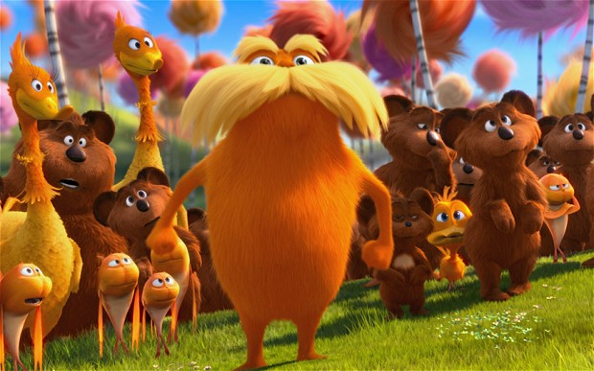

Slide 6
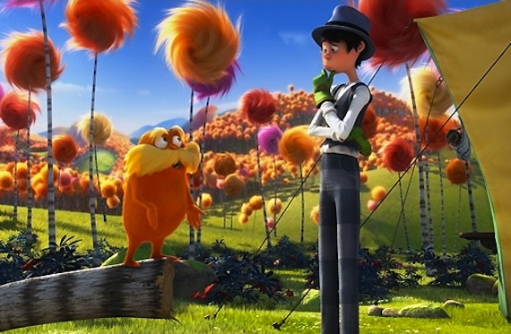

Slide 7
The Once-Lers family join him to begin “biggering and biggering” his business

Slide 8
